Slide 1
YEAR 5 CURRICULUM EVENING
Calculations - Multiplication

Slide 2
Lesson Outline
Multiplying 4 digits by 1 digit
Multiplying 2 digits by 2 digits (area model)
Multiplying 2 digits by 3 and 4 digits

Slide 3
I do
Calculate 3,223 $×$ 3
Thousands | Hundreds | Tens | Ones
 | 3 | 2 | 2 | 3
$×$ |  |  |  | 3
9
6
6
9
Which column do you start with?
Do you need to make an exchange?
9,669
Have a think
Notes:
I do

Slide 4
We do
There are 2,114 seats in a theatre. The theatre is fully
booked for 3 shows. How many people attend overall?
2,114 $×$ 3
Thousands | Hundreds | Tens | Ones
 | 2 | 1 | 1 | 4
$×$ |  |  |  | 3
6
3
4
2
1
Do you need to make an exchange?
Have a think
6,342 people attend.
Notes:
We do- children complete in pairs on grids with P/V counters

Slide 5
You do
Application

Slide 6
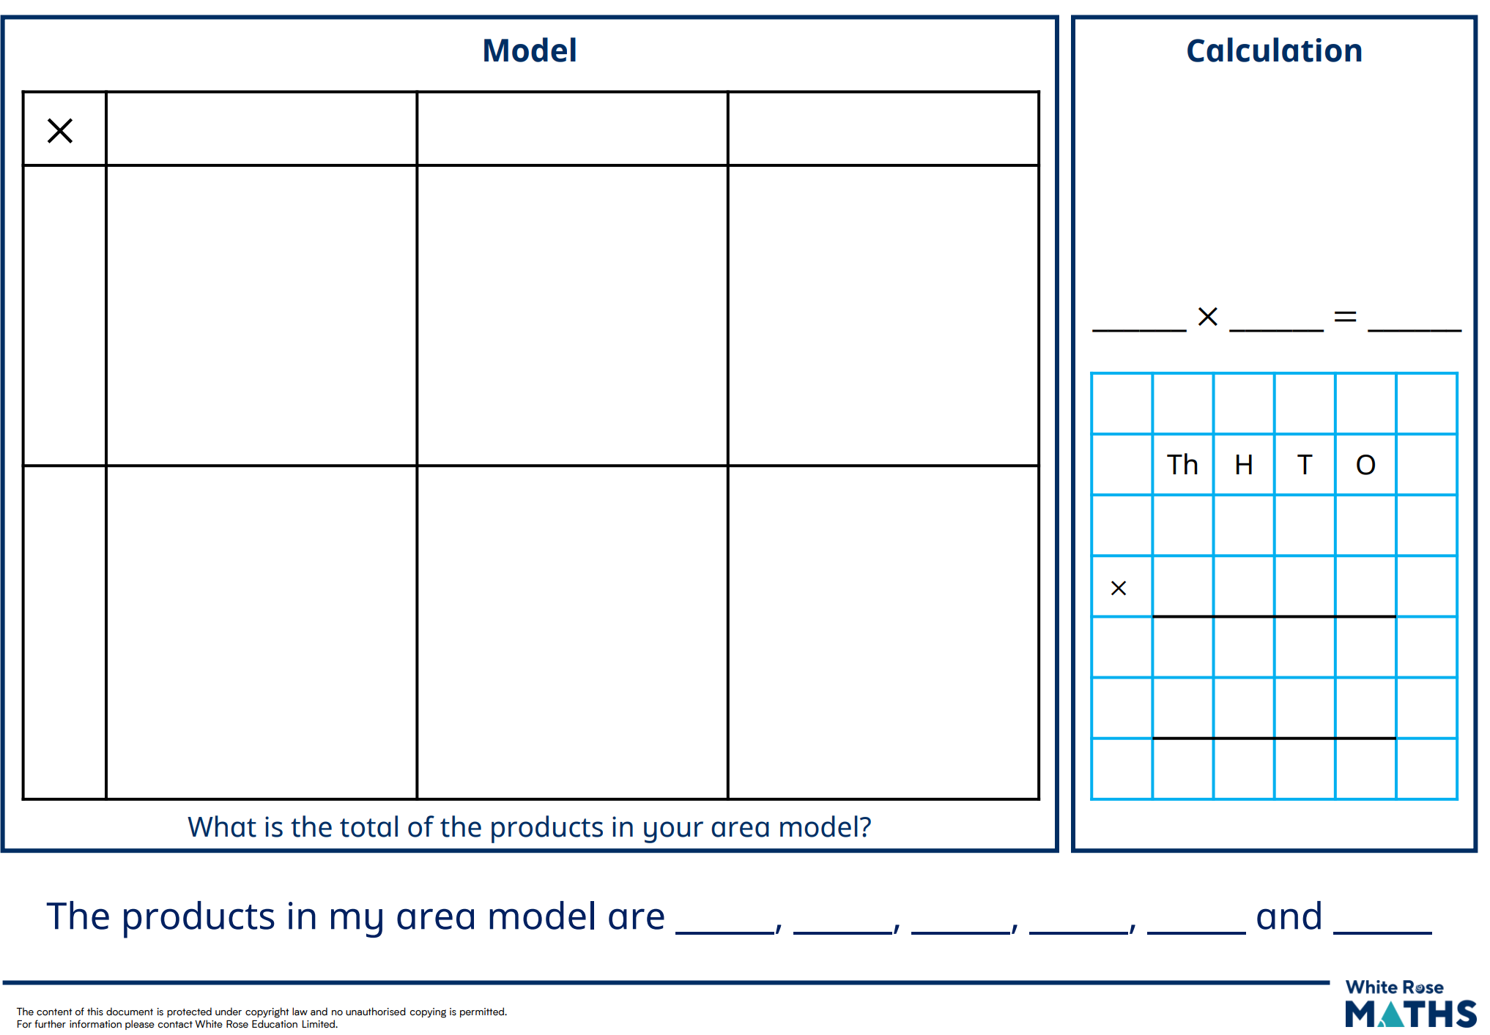
Area Model
Column Method

Slide 7
Formal Methods
Multiplying
Dividing

Slide 8
Complete the calculation to work out 123 $×$ 23
 |  | 1 | 2 | 3
$×$ |  |  | 2 | 3
 |  | 3 | 6 | 9
 | 2 | 4 | 6 | 0
(123 $×$ 3)
(123 $×$ 20)
2
8
2
9
1
Why is there a 0 in the ones column when multiplying by 20?
Have a think

Slide 9
132 $×$ 23
 | Th | H | T | O
 |  | 1 | 3 | 2
$$×$$ |  |  | 2 | 3
$$+$$
3
3
9
6
$($132 $×$ 3$)$

Slide 10
132 $×$ 23
 | Th | H | T | O
 |  | 1 | 3 | 2
$$×$$ |  |  | 2 | 3
$$+$$
2
3
9
6
$($132 $×$ 3$)$
2
6
4
0
$($132 $×$ 20$)$
3
0
3
6
1
1

Slide 11
Reasoning

Slide 12
THANK YOU!
Check out these resources:
Century
Purple Mash
TTRS
Corbett Maths

