Slide 1
Curriculum Evening 22.1.25
Maths - Calculations
Notes:
We want to show you some of the strategies that we use in Year 1 to help the children have a clear and concise understanding of what numbers are, and how they can be manipulated.

Slide 2
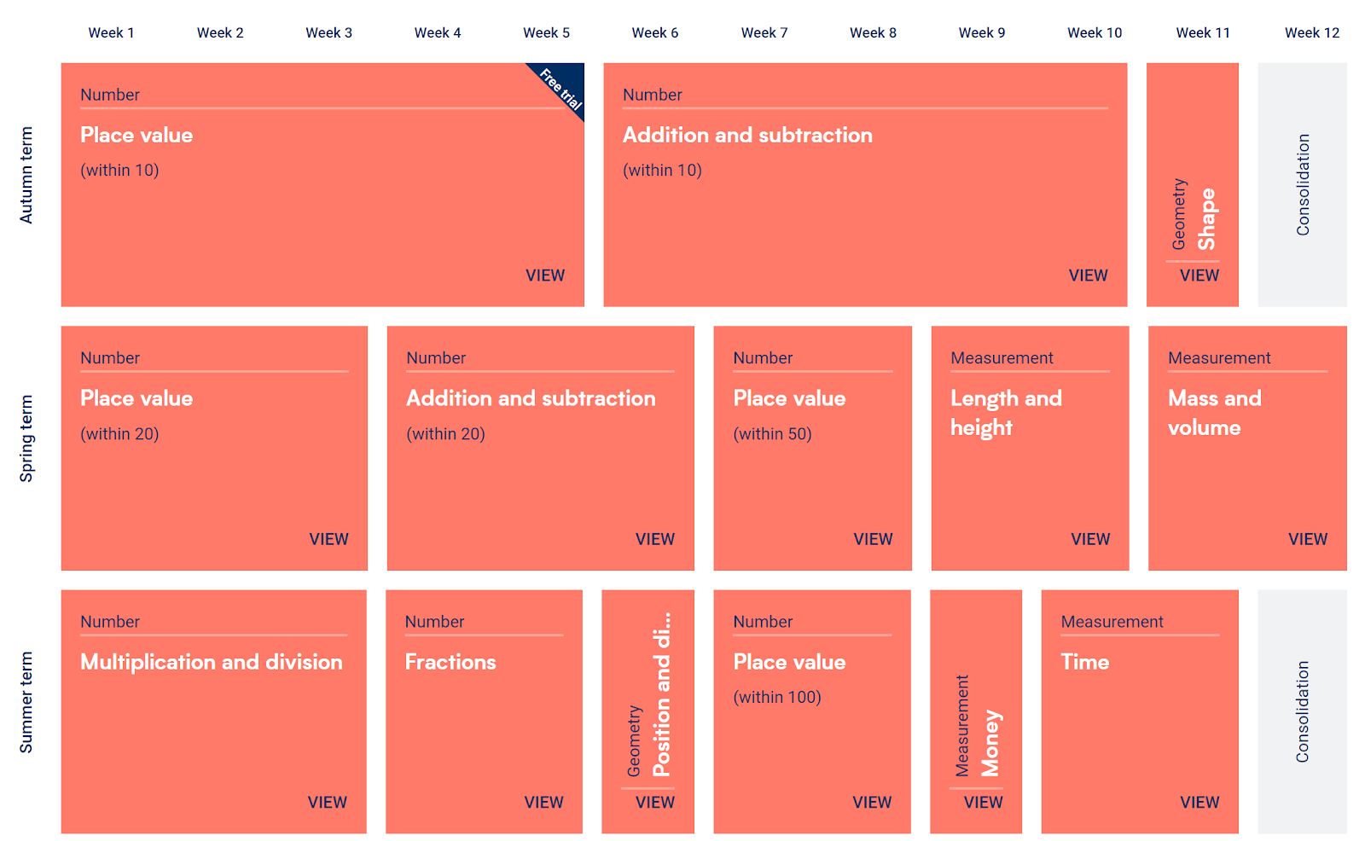
Overview of the year – Year 1 White Rose
Notes:
This is an overview of the maths we cover over the course of year 1, you can see there is a lot of emphasis on place value and addition and subtraction. Place value gives the foundation for maths, so is crucial for their future learning and understanding

Slide 3
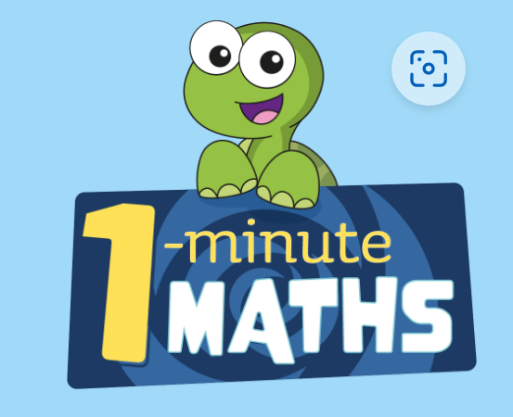
Subitising
This is being able to look at a number of objects, up to 5, and know what that number is without needing to use one to one correspondence to count
Notes:
Use link to demo game

Slide 4
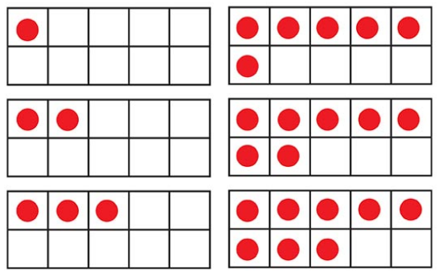
Ten frames
We use ten frames almost daily, to clearly show how numbers can be built and represented.
Notes:
The ten frames help children visually see the numbers we’re talking about, and combined with the subitising creates a powerful tool

Slide 5
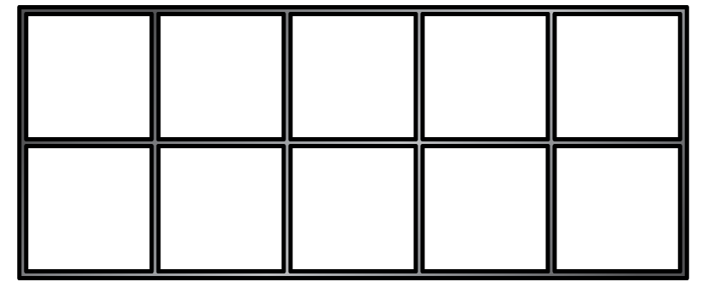
How many counters are there?
Two ten frames are full, so I know that I have made ___
20
Notes:
Here’s an example of how we might use ten frames, and the sort of things we say about them. One full ten frame is representing ten, if there is one gap, we know it is one less than ten so it must be 9 etc

Slide 6
Number bonds – why?
These are the building blocks for any additive calculations (additive covers both adding and subtracting)
Knowing number bonds takes away the cognitive load, in order to focus on everything else!
Notes:
Driving a car analogy

Slide 7
Adding using number bonds
Notes:
We start to add using our number bonds, and again we may use the ten frames to support this. Here we’re looking at the relationship between the numbers, we know that 6 + 2 = 8, and we then see that 16 + 2 = 18. By asking the chn to find what’s the same and what’s different we’re encouraging their use of understanding, leading them to look for patterns in maths which becomes important in their reasoning and problem solving

Slide 8
Adding using number bonds
Notes:
This is an example of an activity we might do to support our learning of adding using number bonds

Slide 9
Adding using number bonds
What do you notice?
Write a number sentence for each addition.

Slide 10
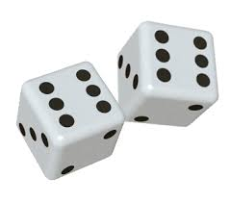
Doubles and near doubles
As with the number bonds, knowing our doubles is important as it frees up space for us to think about the wider problem we’re being faced with.

Slide 11
Doubles and near doubles
Place counters to show
the doubles.
Notes:
Use double sided counters to demo in ten frames

Slide 12
Doubles and near doubles
Notes:
Once we’re secure on our doubles, we can start looking at numbers that are nearly doubles, so for example we can use double 3 work out 3 + 4

Slide 13
Doubles and near doubles

Slide 14
Doubles and near doubles

Slide 15
Reasoning examples
Notes:
We’re going to use the next few slides to show some examples of the reasoning questions the children might be asked to solve - these questions allow the chn a chance to put into practice the knowledge they have learnt.

