Slide 1
Y2 Curriculum Evening
Maths focus

Slide 2
Topics:
Autumn:
Place value
Addition and subtraction
Shape
Spring:
Money
Multiplication and division
Length and height
Mass, capacity and temperature
Summer:
Fractions
Time
Statistics
Position and direction

Slide 3
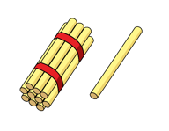
Place value:

Slide 4
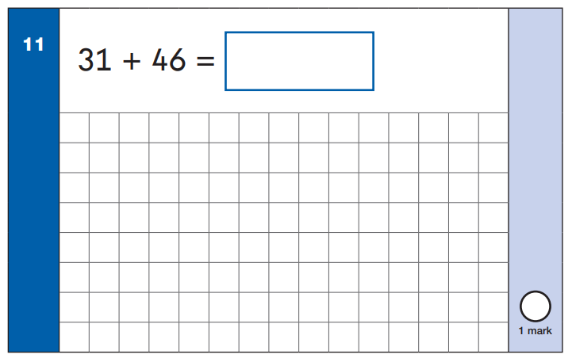
Addition:
Without exchange

Slide 5
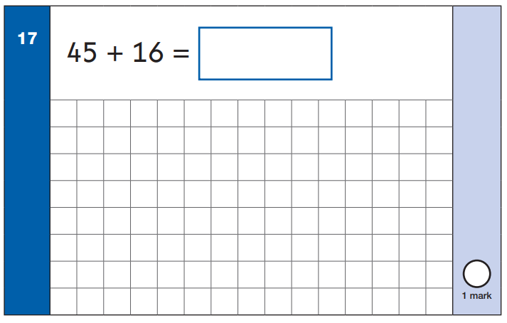
Addition:
With exchange

Slide 6
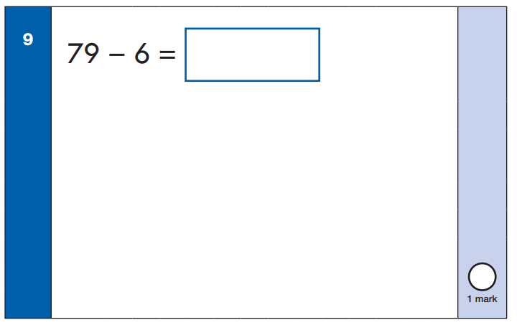
Subtraction:
Without exchange

Slide 7
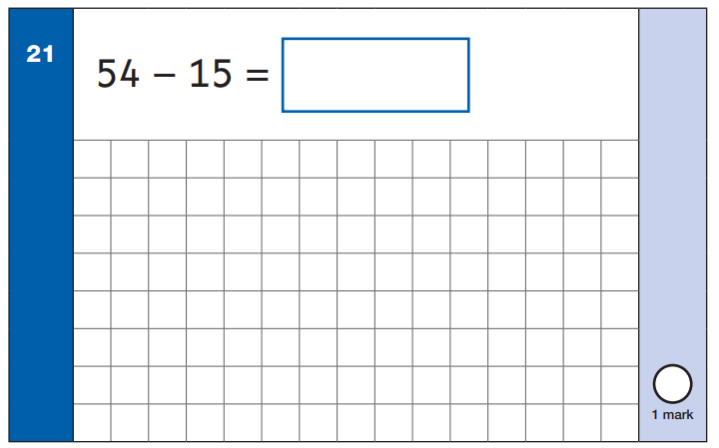
Subtraction:
With exchange

Slide 8
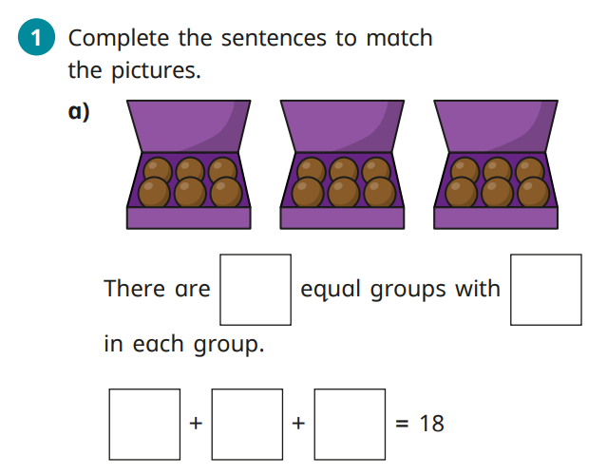
Multiplication and division:
Multiply in 2s, 5s and 10s
Pictorial
Equal groups

Slide 9
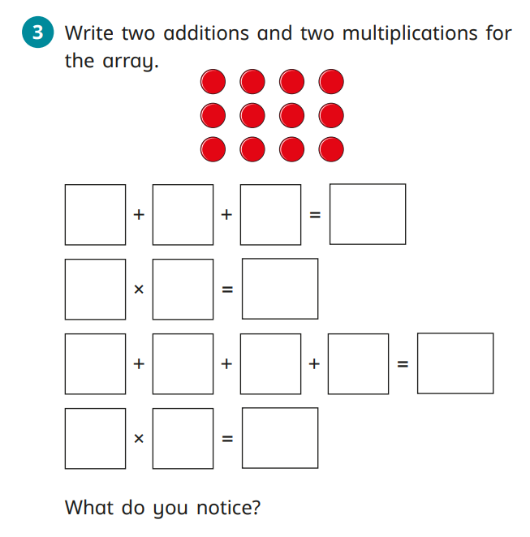
Multiplication and division:
Arrays
Reasoning

Slide 10
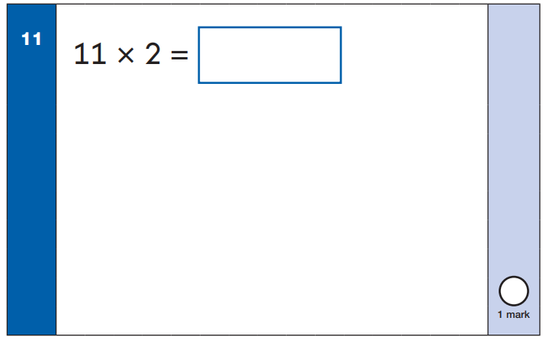
Multiplication and division:
Arrays
Counting in 2s
Drawing groups

Slide 11
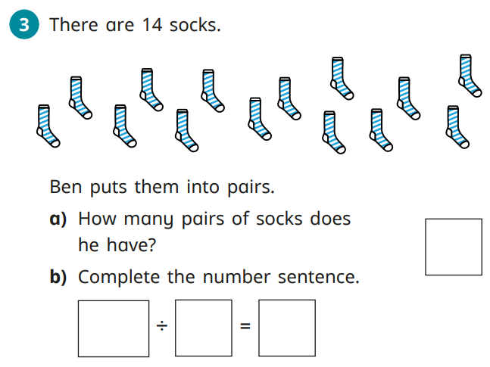
Multiplication and division:
Divide by 2s, 5s and 10s

Slide 12
Multiplication and division:
2s, 5s and 10s

